Slide 1

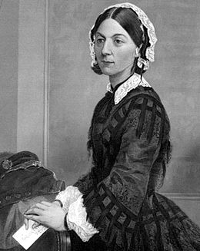
Florence Nightingale
By Caoimhe
This Photo by Unknown Author is licensed under CC BY-SA

Slide 2
Introduction
Hello my name is Caoimhe and I will be taking you through Florence Nightingales life. I chose Florence Nightingale because we are living in a global pandemic and are Doctors, Nurses and Paramedics are on the front line. They are all doing a great job and we thank them everyday……….That’s enough on Coronavirus so lets start

Slide 3

WHY IS FLORENCE NIGHTINGALE FAMOUS?
Florence Nightingale is famous for her nursing work during the Crimean war (1854-1856). She changed the face of nursing from a mostly untrained profession to a highly skilled and well-respected medical profession with very important responsibilitys.

Slide 4
Early life
Florence Nightingale was born in Florence, Italy on the 12th of May 1820. Her Father was a wealthy landlord. Rich girls such as Florence were expected to do – almost nothing. Back then Girls got no education but her Father believed that all women should have an education. Florence’s Dad thought her himself, she learnt Mathematics, Science, History and Philosophy. As Florence grew up she developed an interest in helping others. She cared for sick pets and servants whenever she had the chance.

Slide 5

Older life
At the age of seventeen, she believed that God was calling to her to be a nurse. In 1849 she travelled to Europe to study the European hospital system. Later at the age of thirty-one, she went to Germany to train to be a nurse. Then in 1854 the Crimean War broke out. She then passed away in1910.

Slide 6
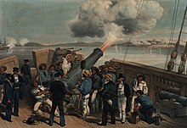
Crimean WAR
This Photo by Unknown Author is licensed under CC BY-SA
In 1852 Florence Nightingale was asked to go to Turkey to manage the nursing of British soldiers wounded in the War (1854-1856). She travelled to Scutari ( Where all the men were sick and wounded). She found the hospitals were in a poor state. There were loads of Diseases and infections spreading throughout the hospital. She knew things had to change. She set up a kitchen, fed the wounded and they were able to take care of the ill properly. The death rate slowly dropped which was a huge success.

Slide 7
FUN FACTS
She refused to get married.
She was a helper from Childhood.
Her nickname was Lady and the lamp as she would walk through the corridors of the hospital with an oil lamp while it was still dark.
She published a book ‘ Notes On Hospital’ .
In 1907, Florence Nightingale became the first woman to receive the ‘Order of Merit’ , given by the Queen.
On May the 12th 2020, people celebrated the washing of the hands which was introduced by Florence Nightingale, it has saved many lives during this pandemic.

Slide 8

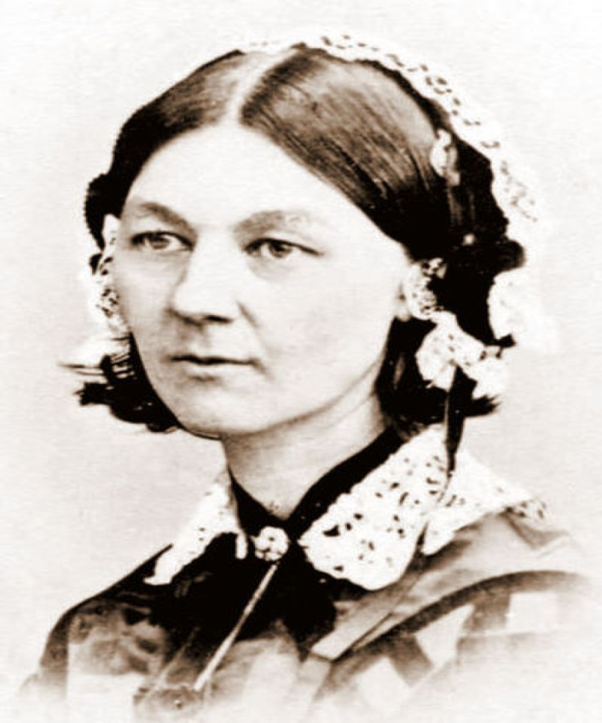

Thank you for watching and I miss ye all
This Photo by Unknown Author is licensed under CC BY-SA

